Slide 1


Slide 2
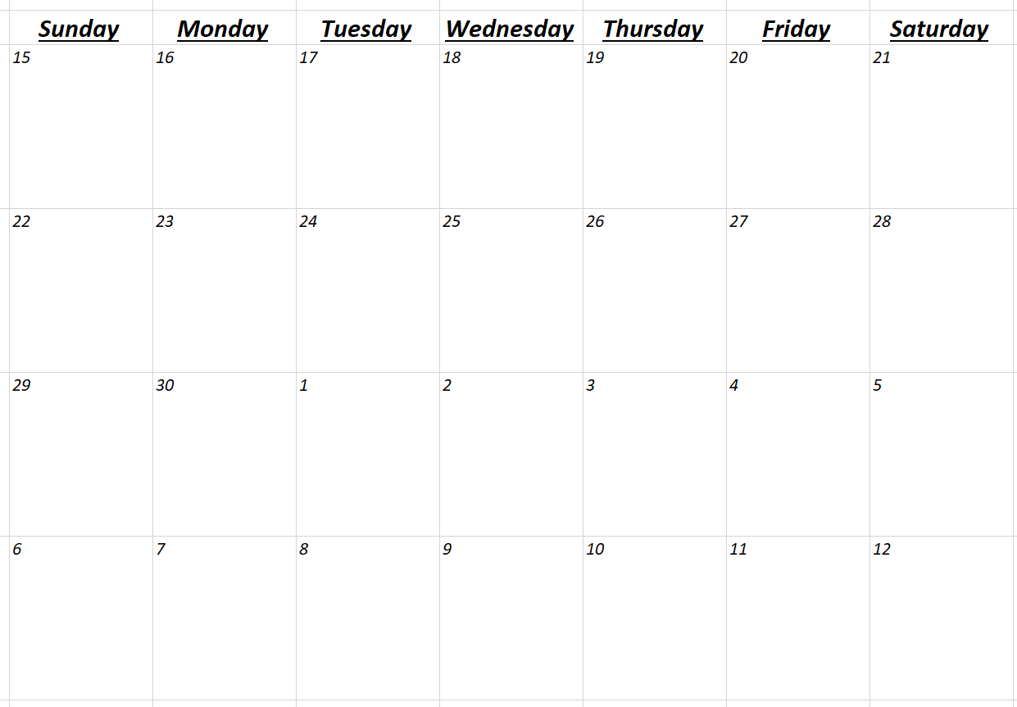
Spatial Statistics
?
Presentations
Presentations
Presentations
Presentations
Final:
10:30 - 1

Slide 3
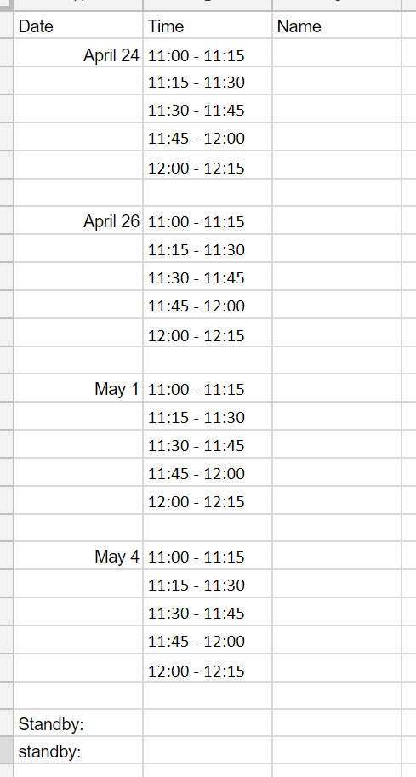
https://docs.google.com/spreadsheets/d/1KgH8wOXCVv5cxIO-AmPd8OyKV8zO6Sf1-IVOidX1uO8/edit?usp=sharing

Slide 4
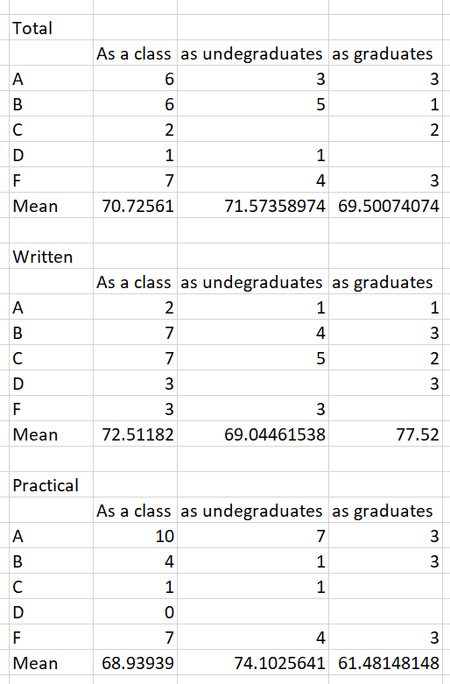
Midterm exam 20%
Final exam 20%
Labs 40%
Final Project 20%

Slide 5
Final Project Presentation
25% of final grade
Project contents (12)
Problem statements (2)
Methods / analysis (4)
Results (4)
Conclusions (2)
Presentation (11)
Text (3)
Diagrams / figures (4)
Verbal communication (4)
Timing (1) (15 minute presentations)
Participation (1)

Slide 6
Papers (65% of the final grade)
Introduction
Define the problem in context. Describe why spatial analysis is needed to solve your problem. Review in literature what methods and spatial analysis have been used solving similar problems. Be sure to include a statement like "The objective of this project is to ...".
Methods
Describe the strategy you solve the problem using GIS and any other necessary methods. Describe the statistic method, computer model, GIS analytic functions / operations you use in the problem solving process. Diagrams are especial helpful to understand your strategy.
Study Area and Analysis
Describe the study area. What kind of GIS data and data models are used in the analysis. Present the results of your analysis.
Results & Conclusions
Discuss the findings from your problem solving process. Evaluate your methodology. Discuss the usefulness and limitation of the analytic functions in GIS.
References

Slide 7
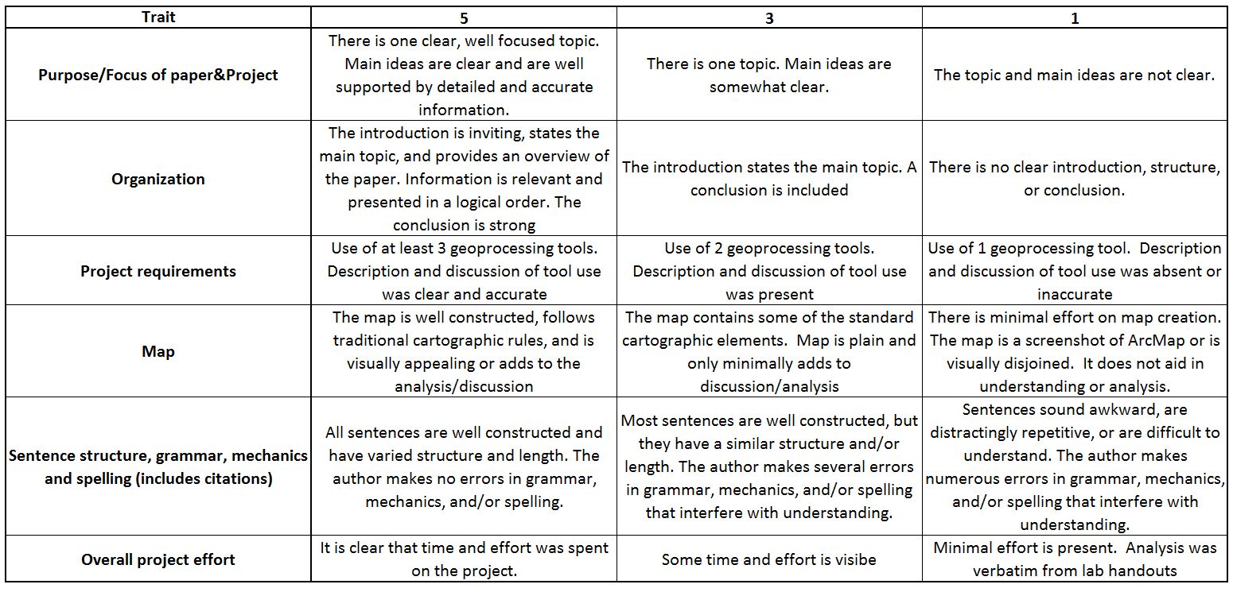

Slide 8


Slide 9
Spatial Statistics
Summarize the key characteristics of a distribution
Identify statistically significant spatial clusters (hot spots/cold spots) and spatial outliers
Assess overall patterns of clustering or dispersion
Partition features into similar groups
Identify features with similar characteristics
Model spatial relationships

Slide 10
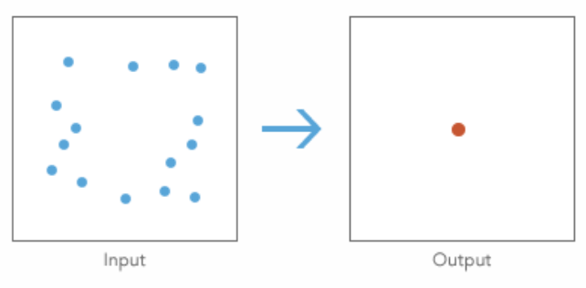
Question: Where is the center
Tools: Mean or Median Center
Example study: Where is the population center?

Slide 11
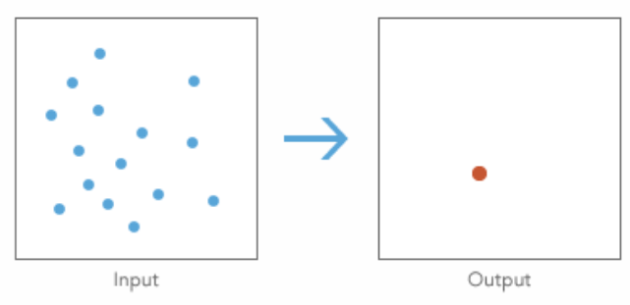
Question: Which feature is most accessible?
Tool: Central Feature
Example study: Where should the headquarters be located?

Slide 12
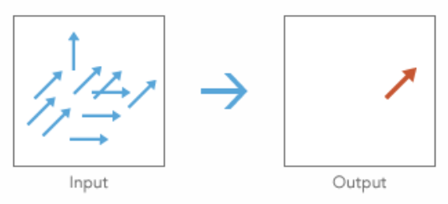
Question: What is the dominant direction?
Tool: Linear Directional Mean
Example study: How are fault lines oriented?

Slide 13
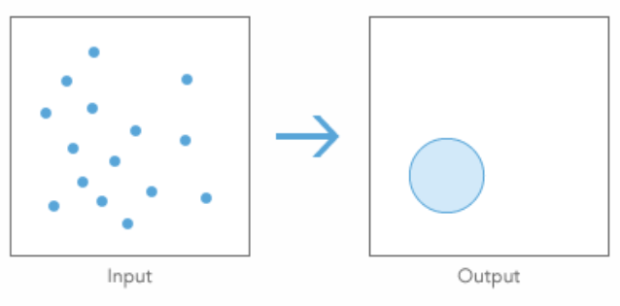
Question: How dispersed, compact, or integrated are features?
Tool: Standard Distance
Example study: Which gang operates over the largest territory?

Slide 14
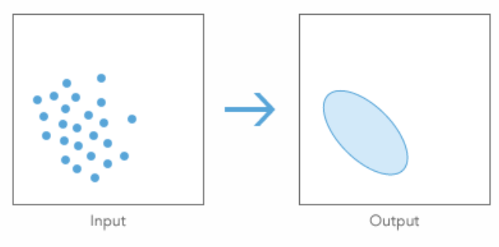
Question: How dispersed, compact, or integrated are features?
Tool: Directional Distribution
Example study: What is the orientation of the debris field?

Slide 15
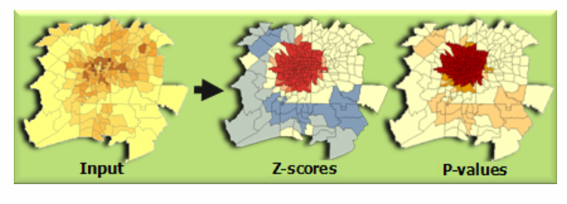
Question: Where are the hot spots? Where are the cold spots?
Tool: Hot Spot Analysis (Getis-Ord Gi*)
Question: Can you do this with point data?

Slide 16
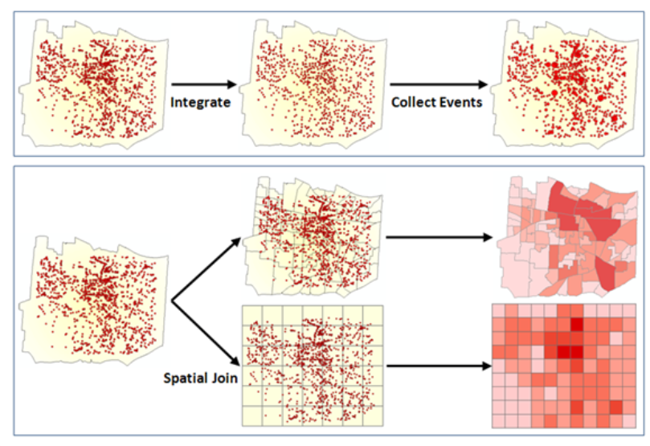

Slide 17
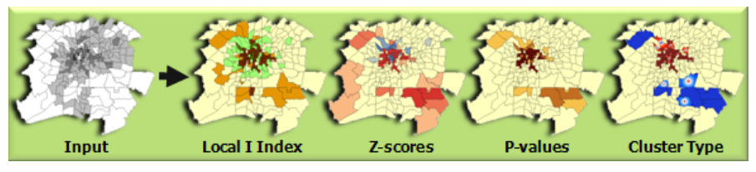
Question: Where are the hot spots? Where are the cold spots?
Tool: Cluster and Outlier Analysis (Anselin Local Moran's I)
Example study: Where do we find anomalous spending patterns in Los Angeles?

Slide 18
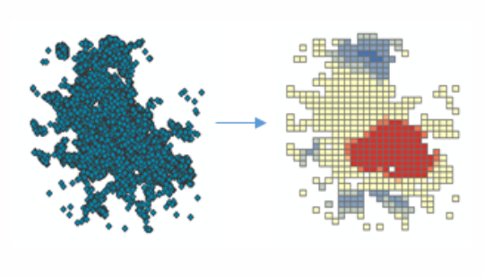
Question: Where are the hot spots? Where are the cold spots?
Tool: Optimized Hot Spot Analysis

Slide 19
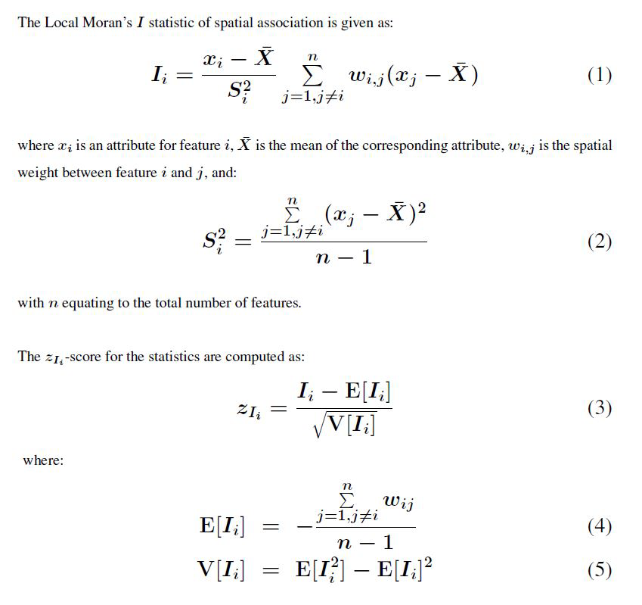
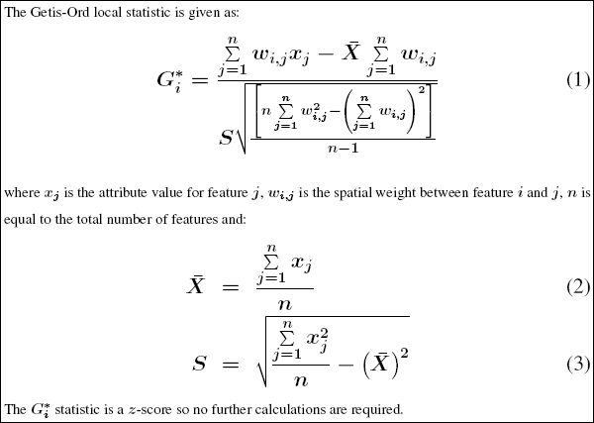

Slide 20
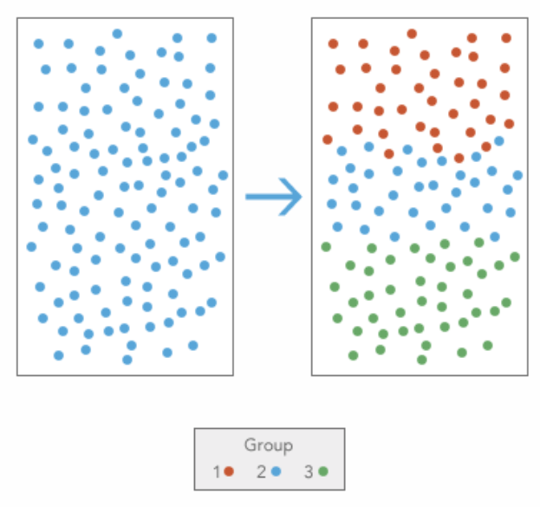
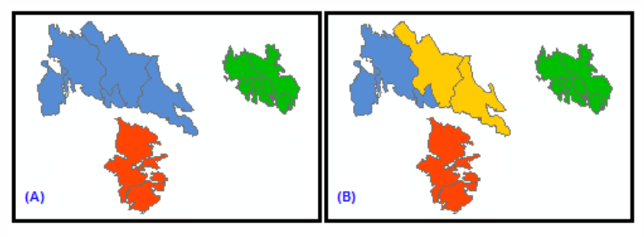
Question: Which features are most alike?
Tool: Grouping Analysis
Example studies:
Which crimes in the database are most similar to the one just committed?
Are there distinct spatial regimes of test scores? Which regions are associated with high test scores and which with low test scores?
Which disease incidents are likely part of the same outbreak based on space, time, and symptoms?

Slide 21
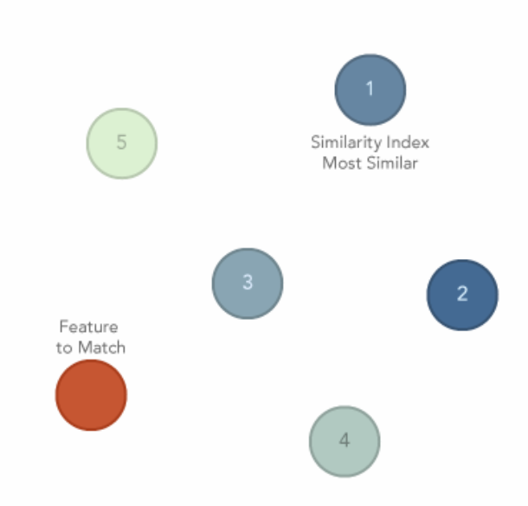
Question: Which features are most similar or dissimilar?
Tool: Similarity Search
Example studies:
Which crimes in the database most closely match a particular crime of interest?
Which regions tested closest to mine
Which outbreak most closely resembles the most current one?

Slide 22
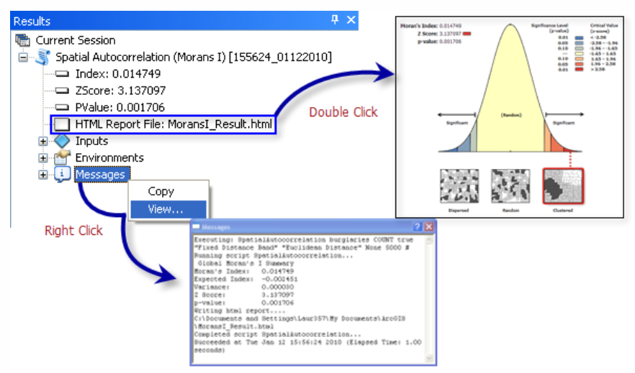
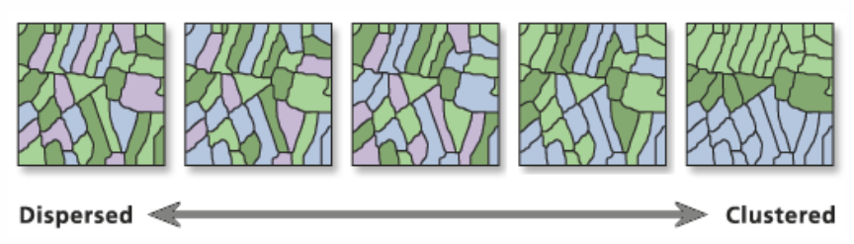
Question: Do spatial characteristics differ?
Tool: Spatial Autocorrelation (Global Moran's I)
Example study: Which types of crime are most spatially concentrated?

Slide 23
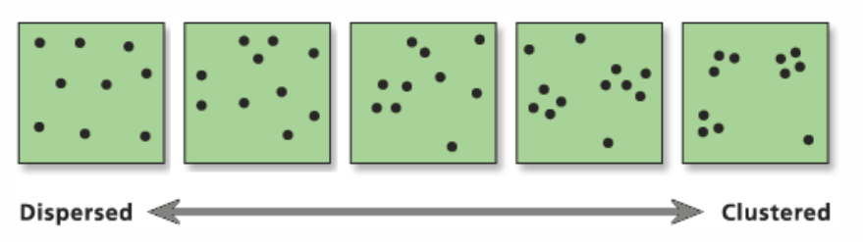
Question: Do spatial characteristics differ?
Tool: Average Nearest Neighbor
Example study: Which plant species is most dispersed across the study area?

Slide 24
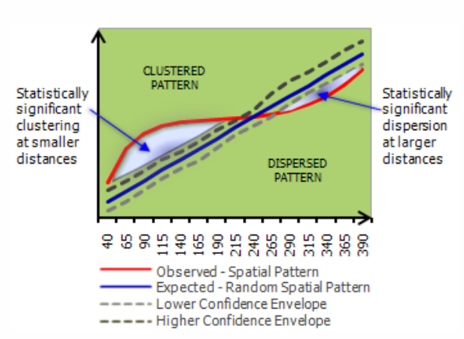
Question: Are the spatial processes similar?
Tool: Multi-Distance Spatial Cluster Analysis (Ripley's K Function)
Example study: Does the spatial pattern of the disease mirror the spatial pattern of the population at risk?

Slide 25
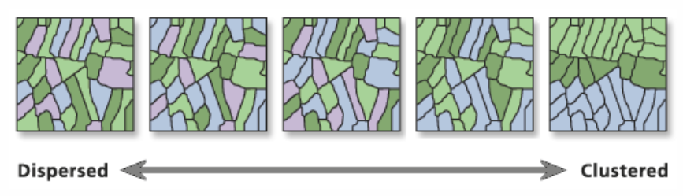
Question: Is the data spatially correlated?
Tool: Spatial Autocorrelation (Global Moran's I)

Slide 26
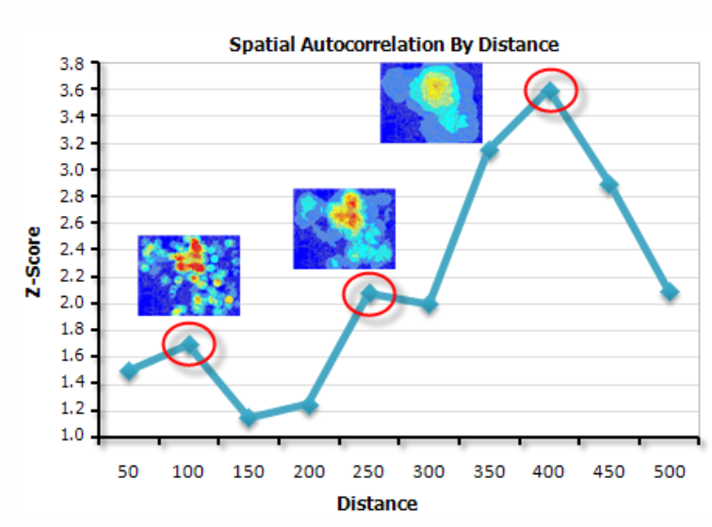
Question: At which distances is spatial clustering most pronounced?
Tool: Incremental Spatial Autocorrelation
Example study: What scale best reflects the appropriate scale of the analysis?

Slide 27
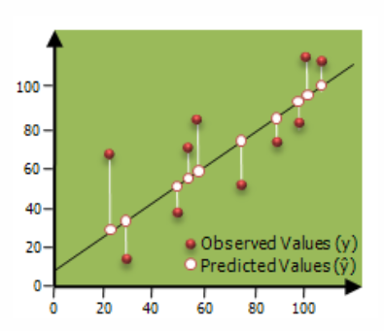
Question: Which variables are the most consistent predictors?
Tool: Ordinary Least Squares (OLS)
Example study: What is the relationship between educational attainment and income?

Slide 28
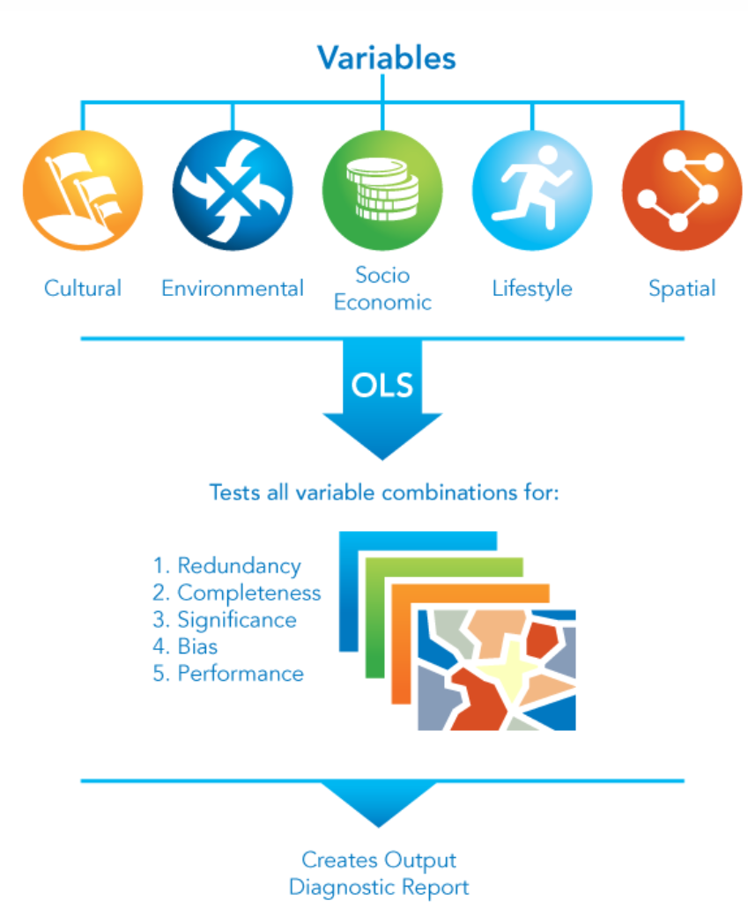
Question: Which variables are the most consistent predictors?
Tool: Exploratory Regression
Example study: Which potential variables should I use for this regression?

Slide 29
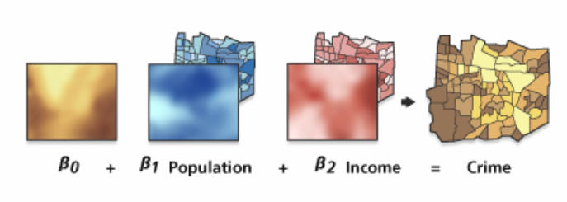
Question: Which variables are the most consistent predictors?
Tool: Geographically Weighted Regression (GWR)
Example study: Does illness increase with proximity to water features?

Slide 30
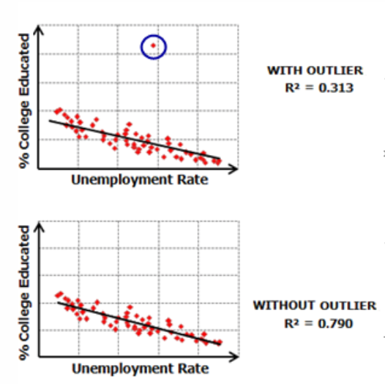
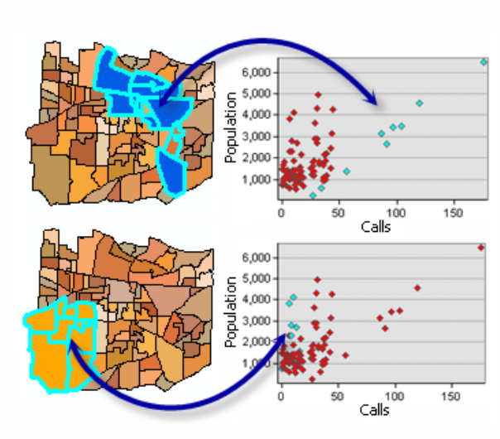
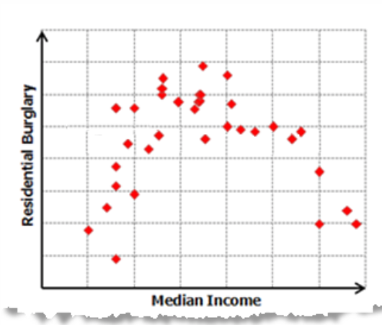
Regression in ArcGIS: Reasons not to trust results

